Slide 1
DIGITAL SCREENING APP FOR A HEALTHIER CAMPUS
CHIMALIS C. MUSHAMBI
UNIVERSITY OF NORTH TEXAS
ADTA 5250 SECTION 001 – LARGE DATA VISUALIZATION
NOVEMBER 18, 2025

Slide 2
Overview
Mental health and related issues
Identify mental health trends and patterns
Discuss data- driven insights
Digital- screening app
Potential impacts of adopting a digital screening app.

Slide 3
Background
The number of college students, suffering from mental health related issues is increasing.
Students struggle silently from anxiety, depression and these issues go unnoticed until the student is overwhelmed and in crisis.

Slide 4
Common mental health disorders
Stress (sleep deprivation, PTSD
Anxiety
Depression
Bipolar disorder
Suicidal ideation

Slide 5
The Hidden Struggle
Stress is masked as productivity.
Anxiety and sleep deprivation.
Working through fatigue to meet deadlines.
Overcommitment to school work and clubs.

Slide 6
Data preparation
Data sources
CDC- National Syndromic Surveillance Program mental health related ER visit rates (Last updated: November 25, 2025)
CDC- National Health Interview Survey mental health indicators (Last updated: August 27, 2025)
Data cleaning
Tableau Prep (handle missing values, duplicates, and adjust data types).
Data Visualization
Tableau Desktop 2025.2

Slide 7
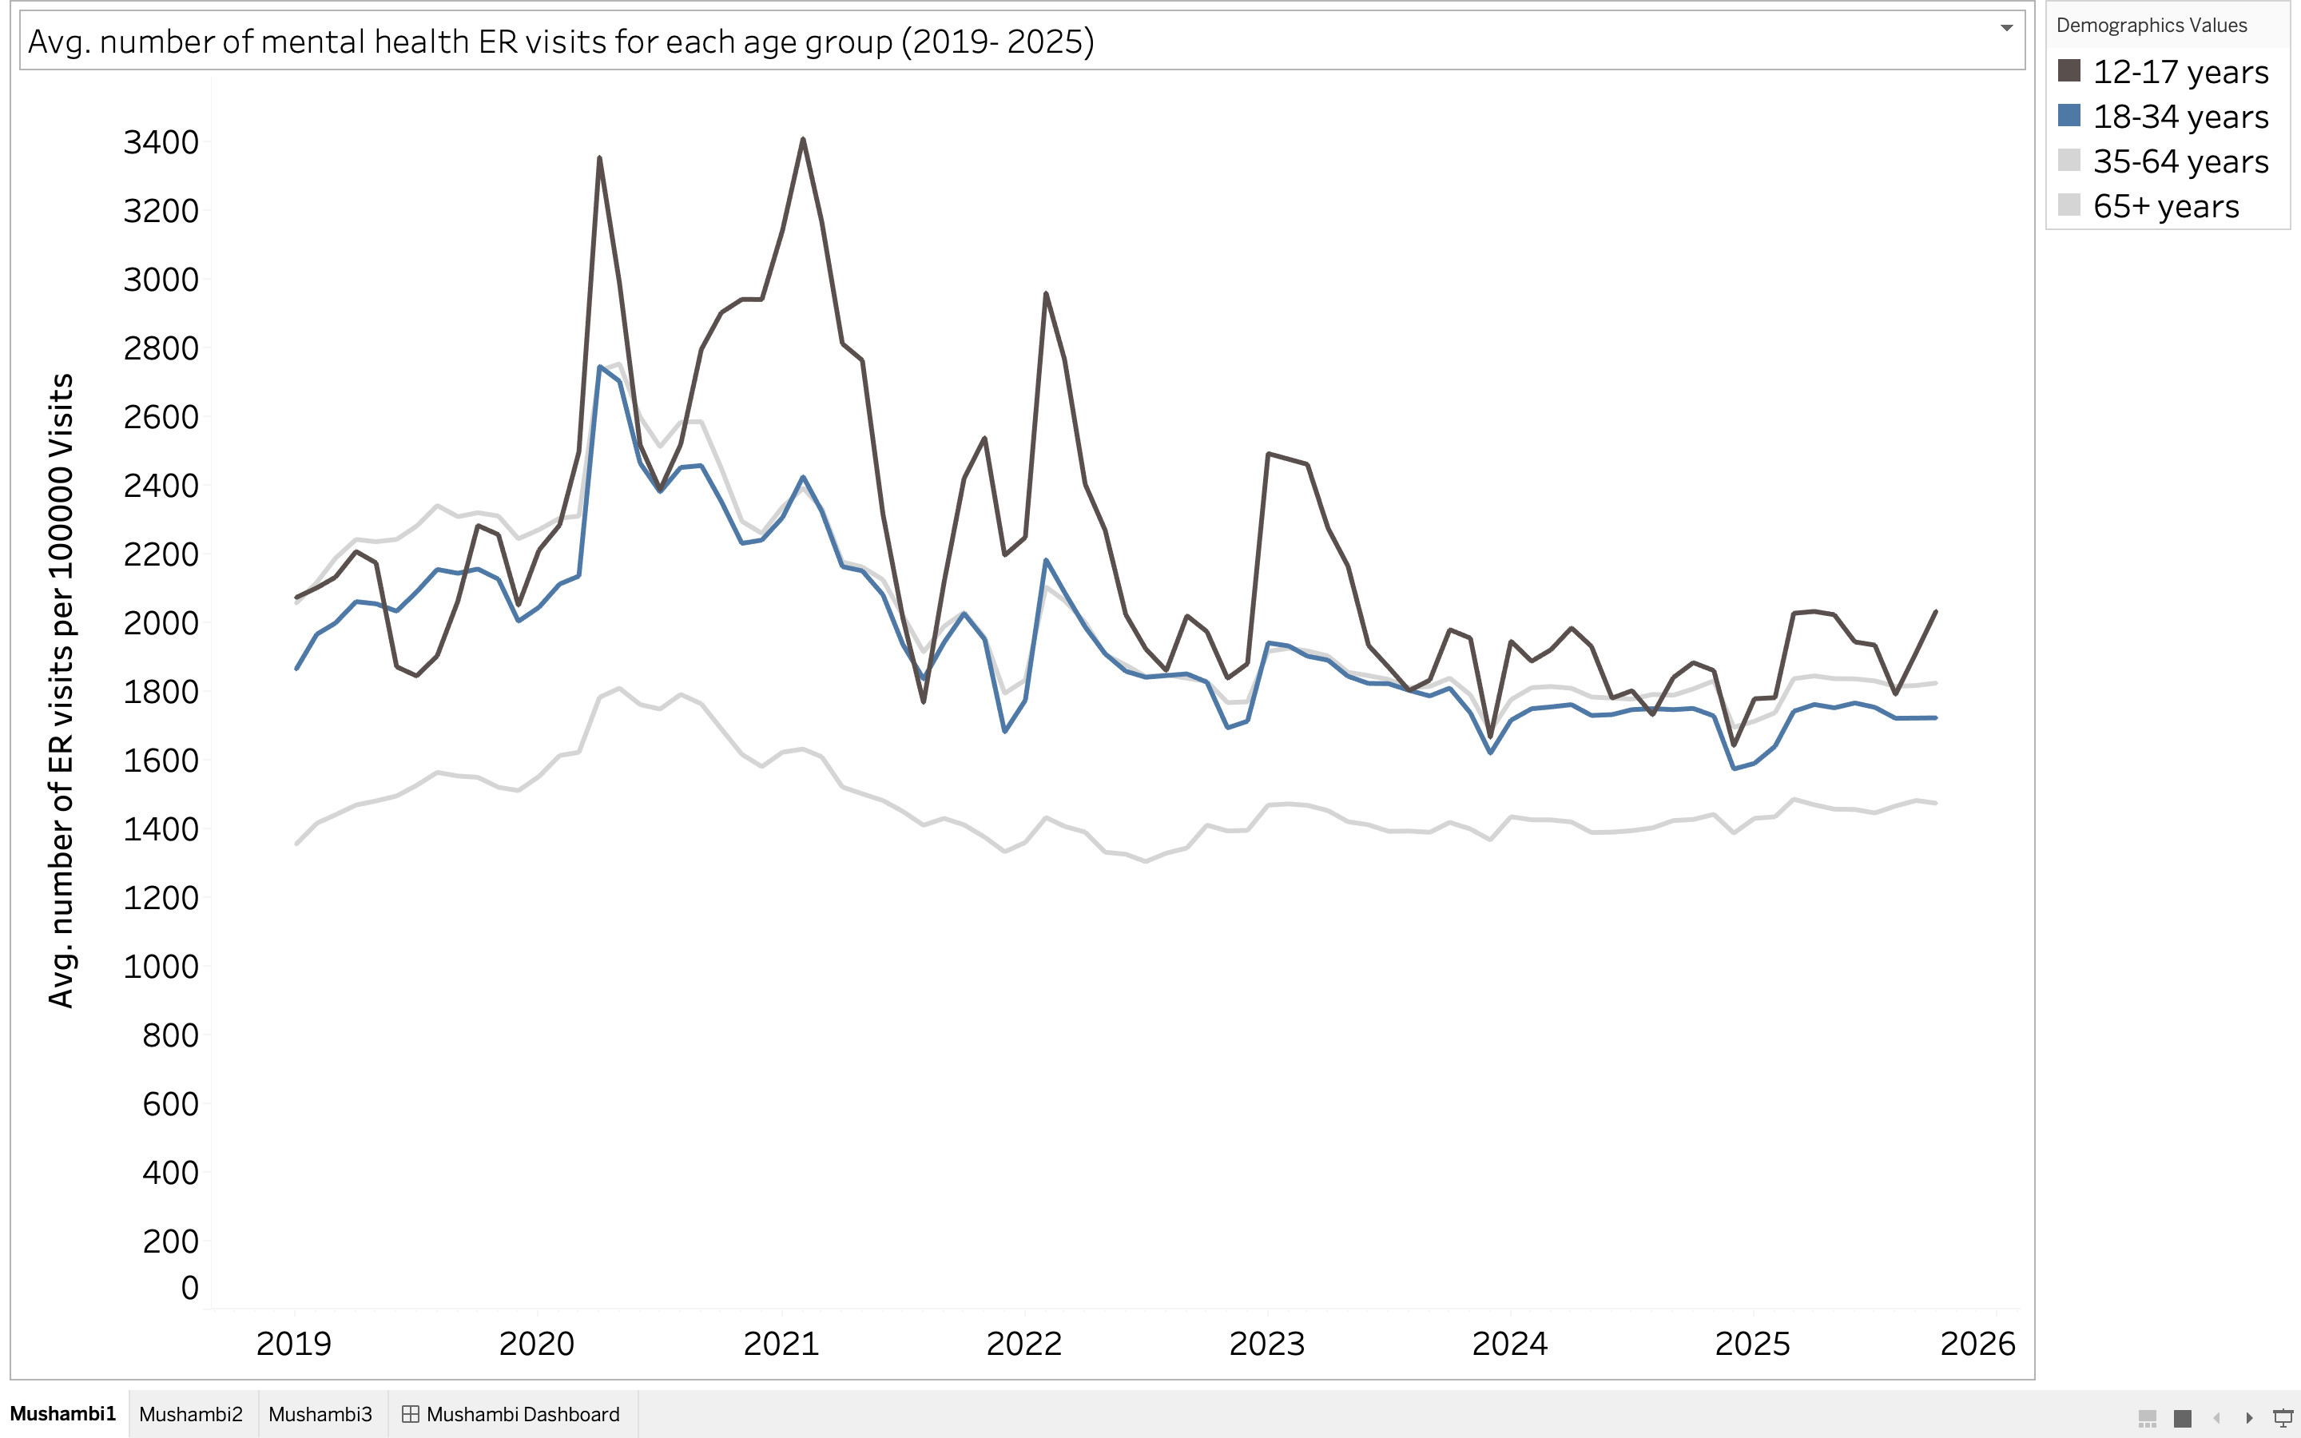
ER visit rates
ER visits rates high during pandemic
Slightly higher ER rates in 2025 (18-34)
Higher than end of 2024 (100+ more visits)
High ER visit rates for high school students consitently over the 7yrs.
Figure 1: Generated using Tableau Desktop November 30, 2025

Slide 8
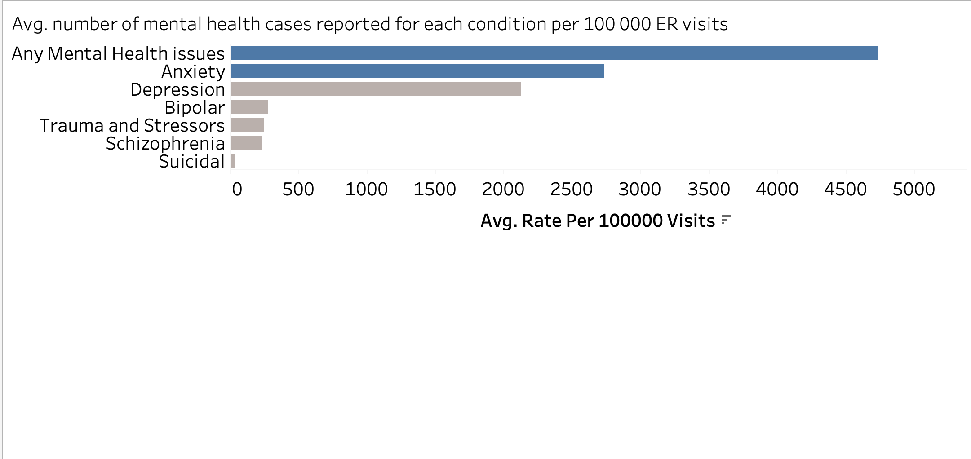
Prevalance of Conditions
Highest number of any mental health issues.
Several people with mental issues but no specific diagnosis and are not receiving condition specific treatment.
Anxiety is second most common in young adults (18- 34yrs)
Figure 2: Generated using Tableau Desktop November 30, 2025

Slide 9
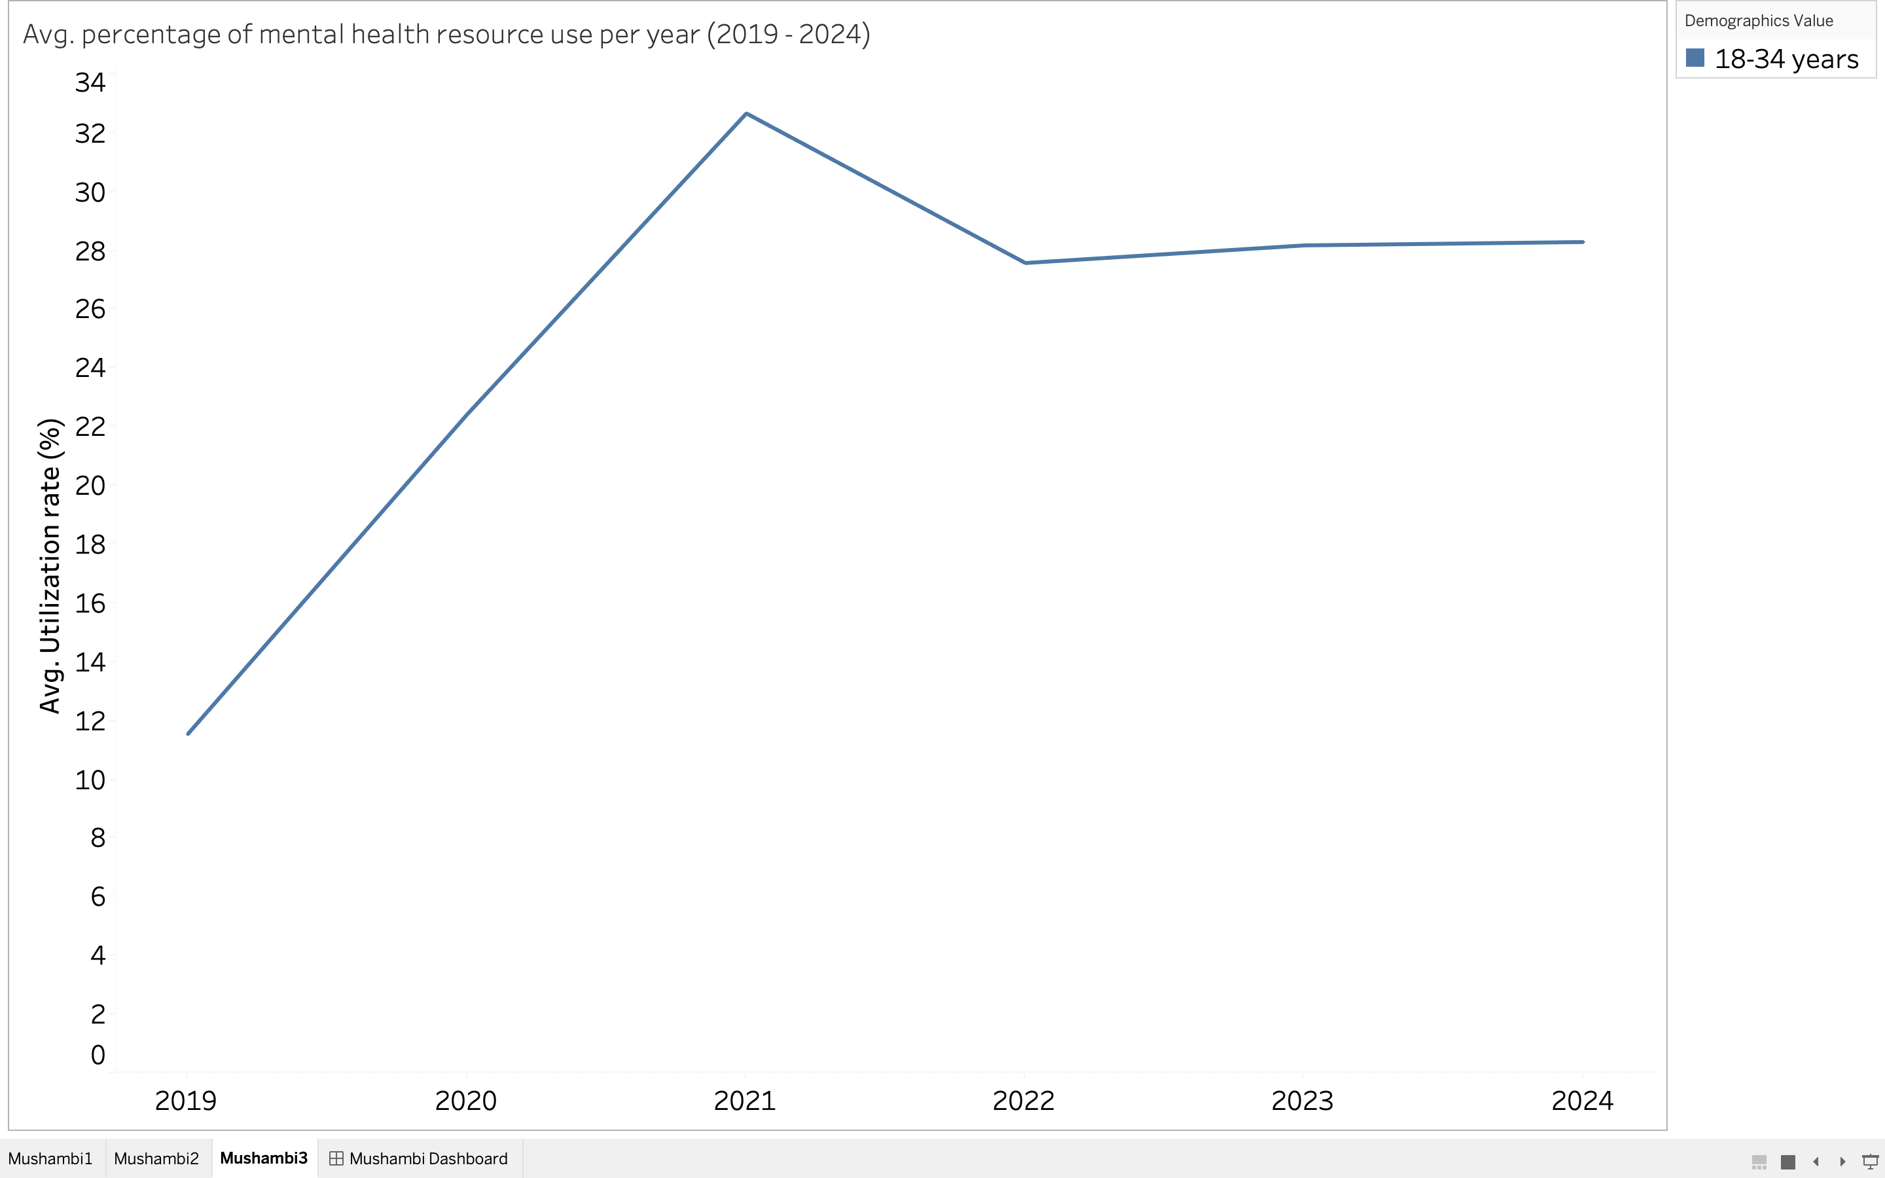
Utilization rate (%)
Rapid increase in use of mental health resources from 2019- 2021.
Pandemic and Post pandemic era
Drastic decrease in utilization from 2021- 2022.
Utilization remains low at 28% from 2022 to 2024.
Utilization mismatches rising ER visits.
Figure 3: Generated using Tableau Desktop November 30, 2025

Slide 10
Mental health issues are on the rise
yet, the number of people seeking care remains low

Slide 11
Current mental health care available
University counselling services through the Student Affairs Center.
Schedule an appointment.
Link to resources available to students.
Emergency resources in times of crisis.

Slide 12
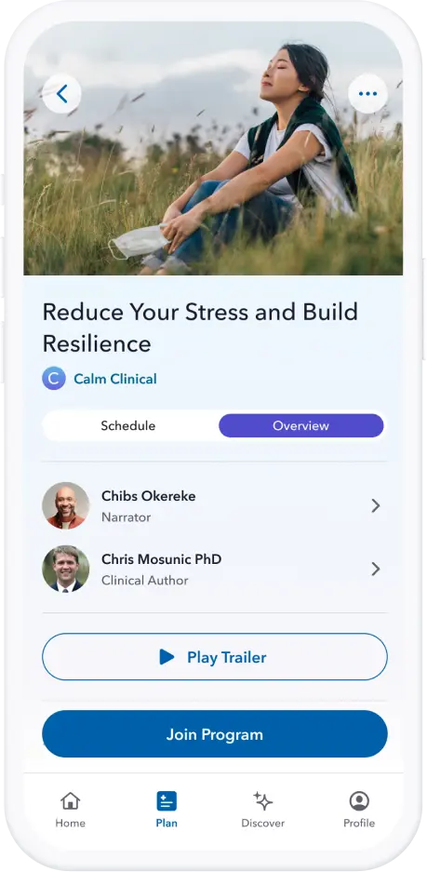
Calm Health app
Subscription based
Access is invite only
Board complaint mental health screening tool.
Users set mental health goals.
In app mindfulness techniques and counselling services.
Pyschologist backed.
Figure 4: Screenshot from calmhealth.com app taken from on December 01, 2025

Slide 13
Digital mental health screening app on campus
Free student access with enrollment.
University sponsored access.
Included as part of new student orientation.
Equip freshman with resources to avoid crisis as high school students have highest ER visit rates.
Personalized mental health resources for students identified as high risk
In app diagnosis
Mindfulness technique suggestions to calm anxiety
Maintains student privacy
Only counselling services have access to student profiles.

Slide 14
Potential Impacts of the Digital self- screening tool
Early detection of mental health issues before crisis.
Reduced stigma around mental health issues.
Safer and healthier campus.

Slide 15
Conclusion
Mental health cases are on the rise and so should the the care for individuals suffering from these issues.
A digital app can help students keep track of their mental health status and seek care before crisis.

Slide 16
References
Knaflic, C. N. (2025). Storytelling with data: A Data Visualization Guide for Business Professionals. JOHN WILEY.
Centers for Disease Control and Prevention. (2025, August 27). National Health Interview Survey (NHIS) - Mental Health Indicators. Centers for Disease Control and Prevention. https://data.cdc.gov/Mental-Health/National-Health-Interview-Survey-NHIS-Mental-Healt/d89q-62iu/about_data
Centers for Disease Control and Prevention. (2025, November 25). National Syndromic Surveillance Program (NSSP) mental health-related emergency department visit rates. Centers for Disease Control and Prevention. https://data.cdc.gov/Mental-Health/National-Syndromic-Surveillance-Program-NSSP-Menta/eze9-ahe5/about_data

Slide 17
Thank you for our time.
Any Questions?

